Slide 1
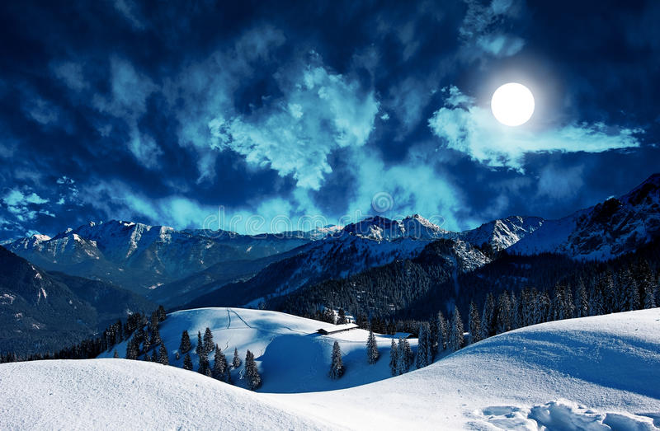
Chapter 12
First meeting with Mr Rochester

Slide 2

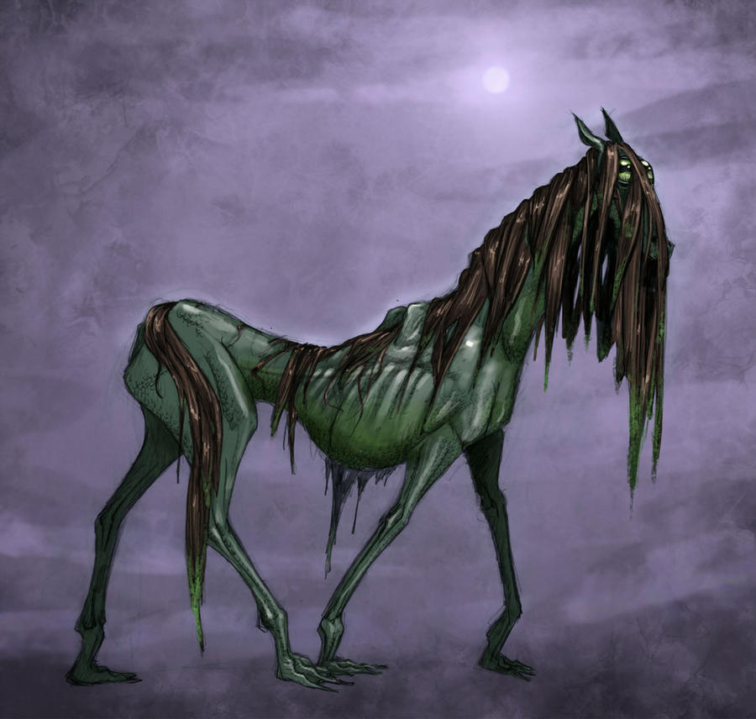
The supernatural
Bessie’s tales
Gloomy atmosphere
Gytrash

Slide 3
Sight | Sound
- seeing his master | - I heard - a sliding sound - echoed the sound

Slide 4
The two characters’ personality
Jane is helpful and daring
The man seem brave and autonomous

Slide 5
How Jane describe the rider’s physical appearance ?
- a middle-highted man
- a dark face with stern’s features, heavy brow, his eyes and gathered eyebrows looked ireful and thwarted

Slide 6
The symbols of virility
Riding cloak
Fur collared
Steel clapsed
Breadth of chest
Dark face
Stern features
Heavy brow
Thwarted eyes
Handsome, heroic-looking gentleman
I met those qualities incarnate in masculine shape
Frown, roughness

Slide 7
Characters’ conversation
A cold tone with short sentences
The readers may feel puzzled by the behaviour of Jane towards Mr. Rochester’s attitude, who is attracted by his roughness

Slide 8
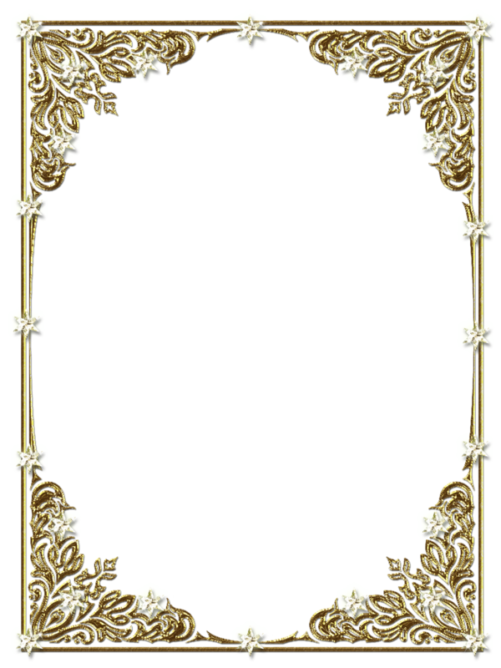
Like heath that, in the wilderness,
The wild wind whirls away.
Quotation from Thomas Moore
Alliteration in -w- : Harmony
Like the wind that whirls again and again
Reader can sense it

